Slide 1

A MINOR PROJECT ON FACE RECOGNITION USING PYTHON
Submitted By -
SOUNAK SARKAR
ROHIT DEY
SAYAN PODDAR
MD. ZEESHAN
SHEEBA TAZEEN

Slide 2
What is facial recognition?
Facial recognition is a way of identifying or confirming an individual’s identity using their face. Facial recognition systems can be used to identify people in photos, videos, or in real-time.
Facial recognition is a category of biometric security. Other forms of biometric software include voice recognition, fingerprint recognition, and eye retina or iris recognition. The technology is mostly used for security and law enforcement, though there is increasing interest in other areas of use.

Slide 3
How does facial recognition work?
Many people are familiar with face recognition technology through the FaceID used to unlock iPhones (however, this is only one application of face recognition). Typically, facial recognition does not rely on a massive database of photos to determine an individual’s identity — it simply identifies and recognizes one person as the sole owner of the device, while limiting access to others.
Beyond unlocking phones, facial recognition works by matching the faces of people walking past special cameras, to images of people on a watch list. The watch lists can contain pictures of anyone, including people who are not suspected of any wrongdoing, and the images can come from anywhere — even from our social media accounts

Slide 4

Examples of Face Recognition System:
PREVENT RETAIL CRIME
1
UNLOCK PHONES
2
FIND MISSING PERSON
3
DIAGNOSE DISEASES
4
PROTECT LAW ENFORCEMENT
5

Slide 5
Research Methodology
This project uses the following tools for its implementation:
Python: The programming language used to implement this Project.
Jupyter notebook: Used to provide an interactive environment for python, for the implementation of this project.
OpenCV: Is an image and video processing library and is used for image and video analysis, like facial detection, license plate reading, photo editing, advanced robotic vision, optical character recognition, and a whole lot more.
dlib: The dlib library, maintained by Davis King, contains our implementation of “deep metric learning” which is used to construct our face embeddings used for the actual recognition process.
Face Recognition: The face_recognition library, created by Adam Geitgey, wraps around dlib’s facial recognition functionality, and this library is super easy to work with and we will be using this in our code. Remember to install dlib library first before you install face_recognition.

Slide 6
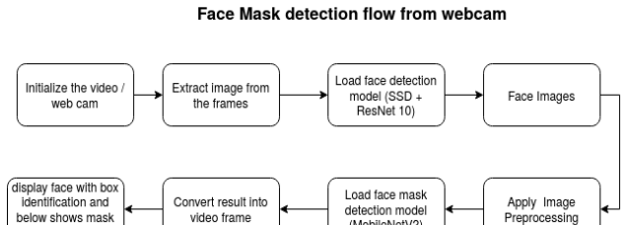
Research Methodology
Flowchart for the Face Detection Model

Slide 7
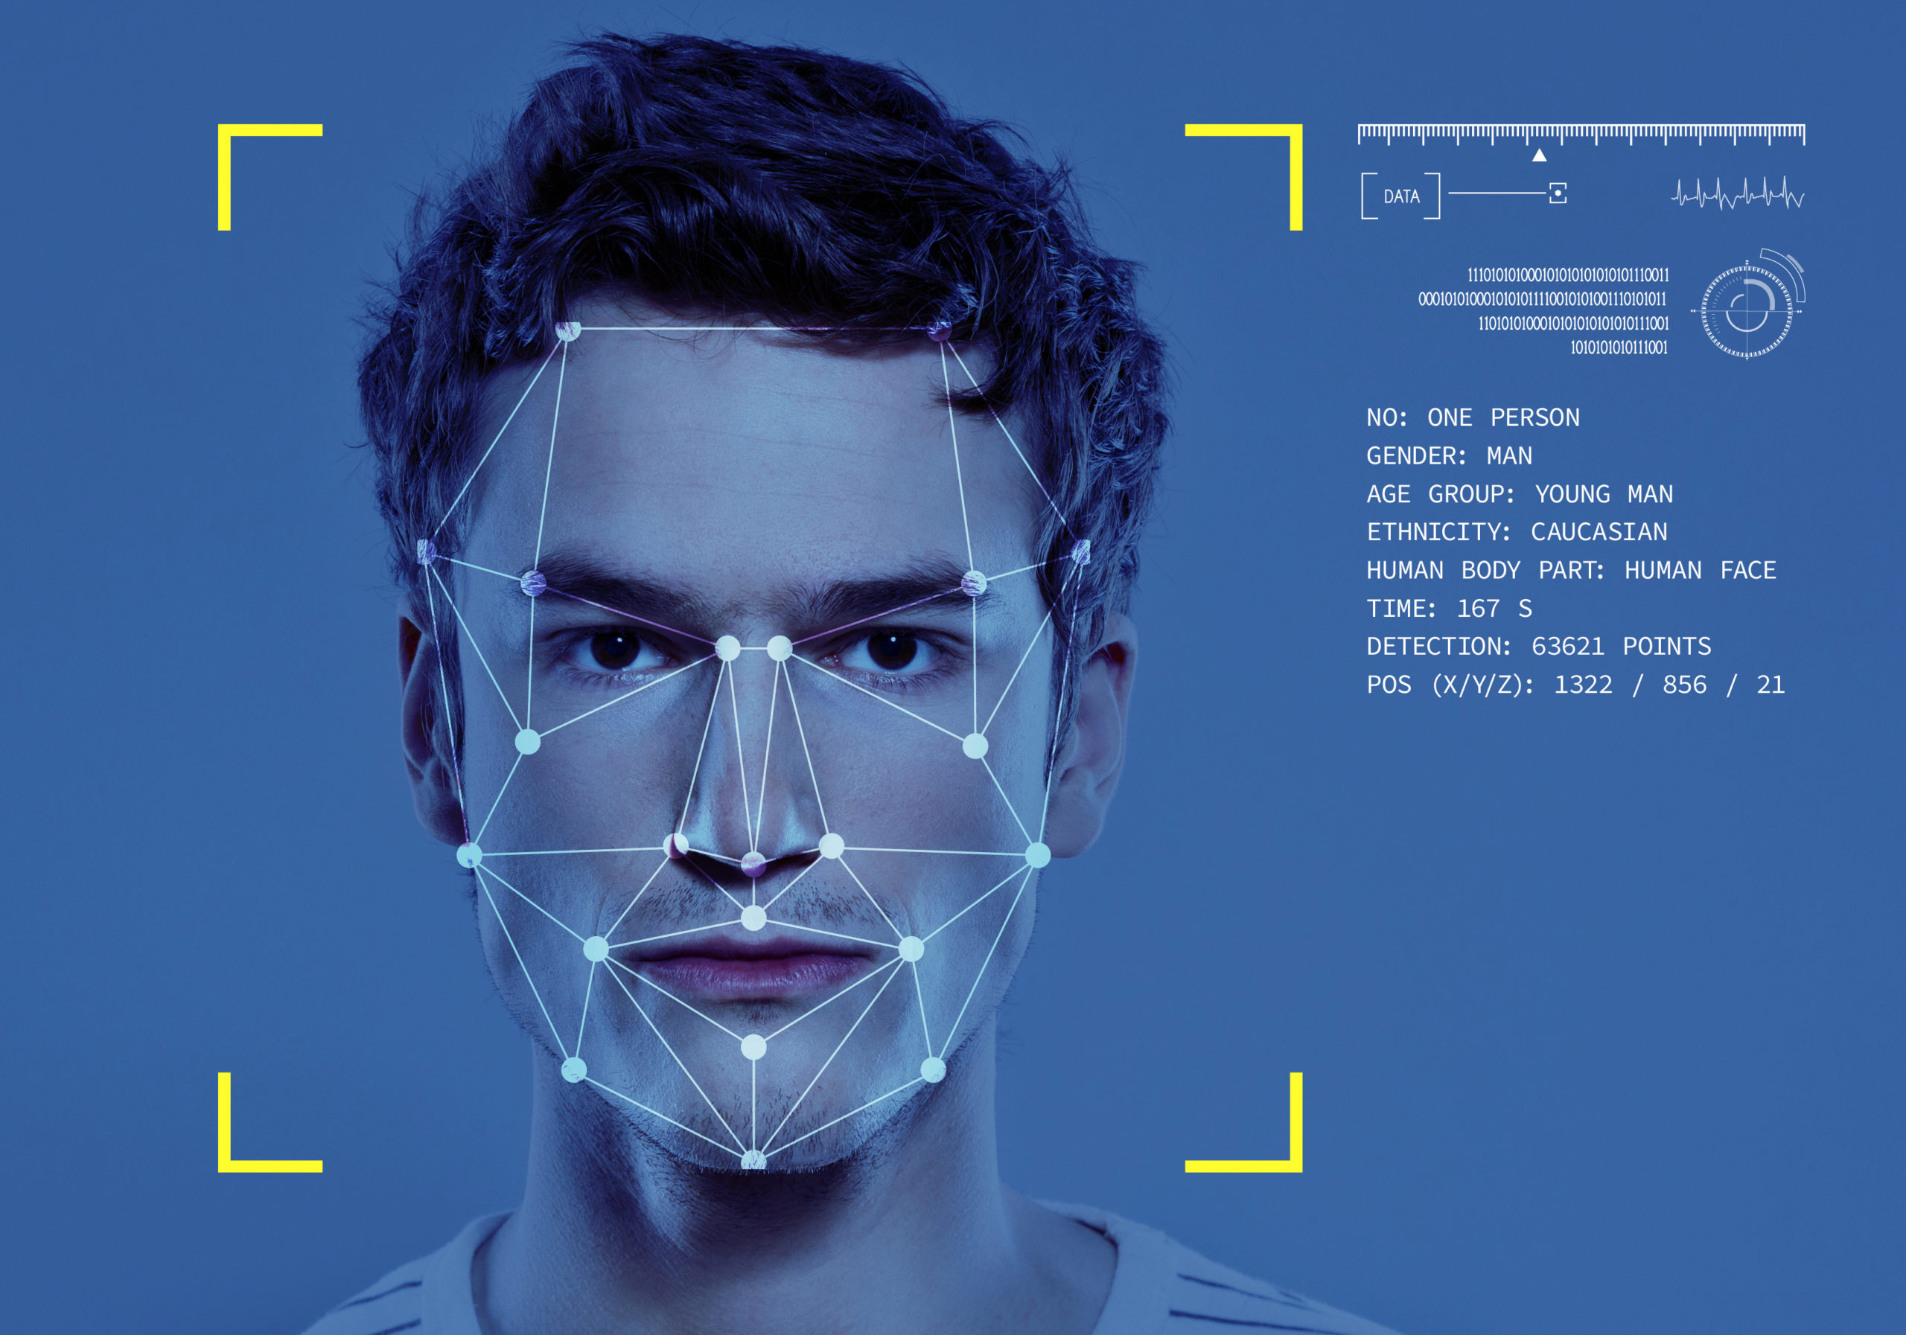
Face Recognition in Webcam Feed:

Slide 8
IMPORT LIBRARIES NECESSARY FOR THIS PROJECT:
from imutils import paths
import face_recognition
import pickle
import cv2
import os

Slide 9
GET PATHS OF EACH FILE IN FOLDER IMAGES: IMAGES HERE CONTAINS MY DATA (FOLDERS OF VARIOUS PERSONS):
imagePaths = list(paths.list_images('Images'))
knownEncodings = []
knownNames = []
# loop over the image paths
for (i, imagePath) in enumerate(imagePaths):
# extract the person name from the image path
name = imagePath.split(os.path.sep)[-2]
# load the input image and convert it from BGR (OpenCV ordering)
# to dlib ordering (RGB)
image = cv2.imread(imagePath)
rgb = cv2.cvtColor(image, cv2.COLOR_BGR2RGB)
#Use Face_recognition to locate faces
boxes = face_recognition.face_locations(rgb,model='hog')
# compute the facial embedding for the face
encodings = face_recognition.face_encodings(rgb, boxes)
# loop over the encodings
for encoding in encodings:
knownEncodings.append(encoding)
knownNames.append(name)

Slide 10
SAVE ENCODINGS ALONG WITH THEIR NAMES IN DICTIONARY DATA
data = {"encodings": knownEncodings, "names": knownNames}
#use pickle to save data into a file for later use
f = open("face_enc", "wb")
f.write(pickle.dumps(data))
f.close()

Slide 11
FIND PATH OF XML FILE CONTAINING HAARCASCADE FILE:
cascPathface = os.path.dirname(
cv2.__file__) + "/data/haarcascade_frontalface_alt2.xml"
# load the harcaascade in the cascade classifier
faceCascade = cv2.CascadeClassifier(cascPathface)
# load the known faces and embeddings saved in last file
data = pickle.loads(open('face_enc', "rb").read())

Slide 12
LOOP OVER FRAMES FROM THE VIDEO FILE STREAM GRAB THE FRAME FROM THE THREADED VIDEO STREAM:
print("Streaming started")
video_capture = cv2.VideoCapture(0)
# loop over frames from the video file stream

Slide 13
while True:
# grab the frame from the threaded video stream
ret, frame = video_capture.read()
gray = cv2.cvtColor(frame, cv2.COLOR_BGR2GRAY)
faces = faceCascade.detectMultiScale(gray,
scaleFactor=1.1,
minNeighbors=5,
minSize=(60, 60),
flags=cv2.CASCADE_SCALE_IMAGE)

Slide 14
convert the input frame from BGR to RGB
rgb = cv2.cvtColor(frame, cv2.COLOR_BGR2RGB)
# the facial embeddings for face in input
encodings = face_recognition.face_encodings(rgb)
names = []
# loop over the facial embeddings incase
# we have multiple embeddings for multiple fcaes
for encoding in encodings:
#Compare encodings with encodings in data["encodings"]
#Matches contain array with boolean values and True for the embeddings it matches closely
#and False for rest
matches = face_recognition.compare_faces(data["encodings"],
encoding)
#set name =inknown if no encoding matches
name = "Unknown"
# check to see if we have found a match

Slide 15
if True in matches:
#Find positions at which we get True and store them
matchedIdxs = [i for (i, b) in enumerate(matches) if b]
counts = {}
# loop over the matched indexes and maintain a count for
# each recognized face face
for i in matchedIdxs:
#Check the names at respective indexes we stored in matchedIdxs
name = data["names"][i]
#increase count for the name we got
counts[name] = counts.get(name, 0) + 1
#set name which has highest count
name = max(counts, key=counts.get)

Slide 16
# update the list of names
names.append(name)
# loop over the recognized faces
for ((x, y, w, h), name) in zip(faces, names):
# rescale the face coordinates
# draw the predicted face name on the image
cv2.rectangle(frame, (x, y), (x + w, y + h), (0, 255, 0), 2)
cv2.putText(frame, name, (x, y), cv2.FONT_HERSHEY_SIMPLEX,
0.75, (0, 255, 0), 2)
cv2.imshow("Frame", frame)
if cv2.waitKey(1) &0xFF == ord('q'):
break
video_capture.release()
cv2.destroyAllWindows()

Slide 17
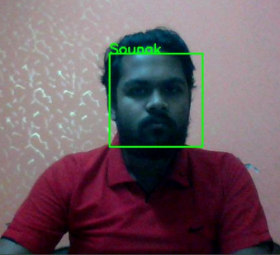
OUTPUT:

Slide 18
CONCLUSION:
We can conclude that: Face recognition is an emerging technology that can provide many benefits. Face recognition can save resources and time, and even generate new income streams, for companies that implement it right.
Face recognition, also called identification involves comparing one input image to all images in an image library in order to determine who the input image belongs to. Or if it does not belong to the database at all.

